Slide 1
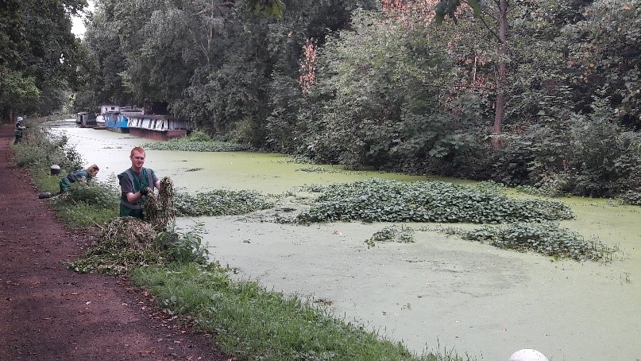
“Your Stretch”
Once Floating Pennywort has been identified and you are ready to co-ordinate a removal event, you must take into consideration everything about “Your Stretch”, with the volunteers safety being paramount. Each risk assessment is site specific. It is the coordinators responsibility to carry out their own risk assessment using the template provided.
www.anglingtrust.net

Slide 2
Things to consider:
Volunteer/Craft & Emergency Access
Car Parking/Toilets
Depth Of Water
Substrate/Silt Depth
Bankside Space
Navigable/Non-Navigable
Flow? No Flow?
Flow Velocity
Other Hazards i.e. Cattle/Nesting Birds/Pollution/Blue Green Algae/Other INNS (i.e. Giant Hogweed, Himalayan Balsam present?)
Risk to or from the Public
Time of year? – Be mindful of spawning fish.
www.anglingtrust.net

Slide 3
10-Point Approach to Floating Pennywort Management
Once taking everything from “Your Stretch” into consideration. You can follow the 10-Point plan for local action groups, by using the following link:
https://www.nonnativespecies.org/local-action-groups-lags/floating-pennywort-strategy/the-10-stage-approach-to-floating-pennywort-management/
Please note: It is good practice to work from the highest reach of the catchment where Floating Pennywort is found. This ensures the Floating Pennywort isn't constantly repopulating after the volunteers hard work.
www.anglingtrust.net

Slide 4
Landowners Permission/Consents
Although your associated club/syndicate may lease the bank and water, it is vital to inform the landowner and gain their permission before carrying out any voluntary events.
Private Ownership – Farmers/Residents
The Environment Agency
The National Trust
Canal & Rivers Trust
Local Authorities
***Please note: If Floating Pennywort is present on/near an Environment Agency asset i.e. locks/weirs, it is then the Environment Agencies responsibility to remove the Floating Pennywort***
If the site falls within a Site of Special Scientific Interest (SSSI). Then it is mandatory for Natural England to be notified by the occupier before any voluntary activity is carried out. Consents can be obtained via emailing: protectedsites@naturalengland.org.uk. Submit your consents as early as possible.
www.anglingtrust.net

Slide 5
Disposing/Composting FP Safely
Composting on the bank is allowed without a licence, although as previously mentioned, landowner permission should be sought.
Prior to removal, locate a convenient location on the bank to place the removed plants.
This area should be pre-agreed with the landowner. It is best to have as few dumping sites as possible and re-use the same locations.
Deposit plants well away from areas which are wetted by the river, at least 3 metres from the channel, and away from banks which could potentially flood, and then leave to rot down – this allows any invertebrates to re enter the water if removed within the Floating Pennywort.
For larger amounts create a long, thin pile which will decompose quicker than a round heaped pile
www.anglingtrust.net

Slide 6
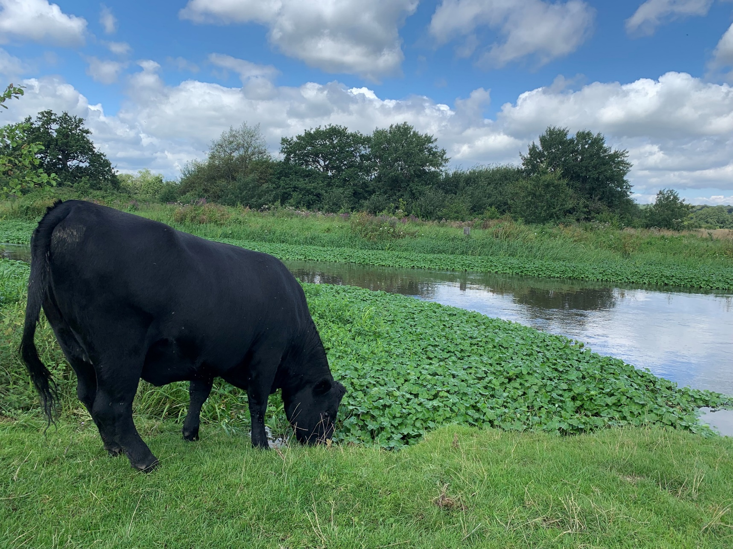
Please note: Floating Pennywort contains a lot of water – Once dumped on the bank it will dry up and turn to a dust within a few weeks of dry weather. Also Cattle love it! Floating Pennywort composting often provides an easy meal for them.
www.anglingtrust.net

Slide 7
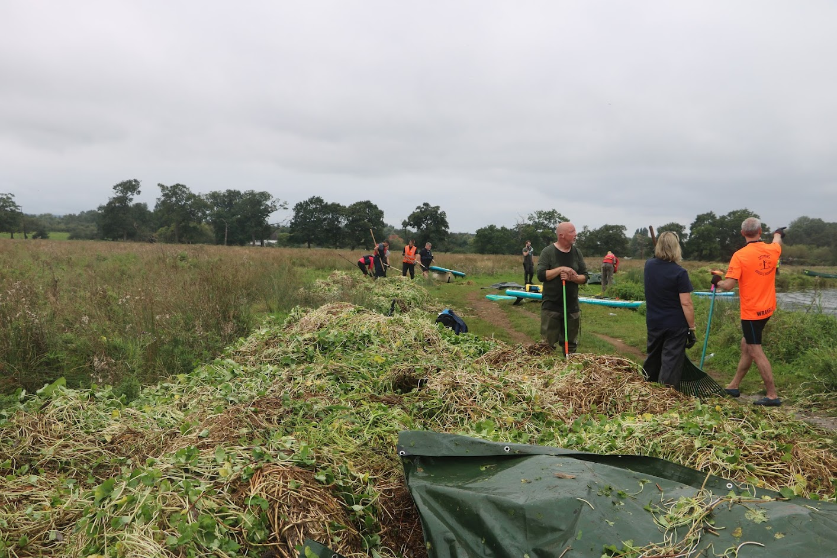
Multiple tonnes of Floating Pennywort safely disposed of and drying out 3m+ from the waters edge after a voluntary removal day
www.anglingtrust.net

