Slide 1
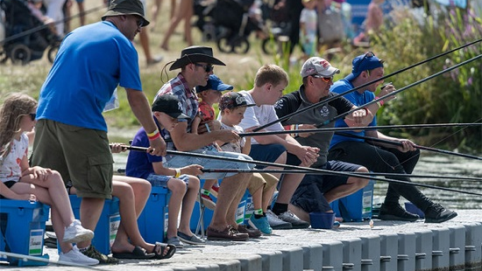
Want to Start Coaching ?
Richard Hadley Coaching Centre Manager

Slide 2

Why Coaching ?
Get more juniors involved to keep clubs going
Give something back
I’m retiring and want something to keep me in pin money
I want to find that piece of gold to coach to win Fishomania

Slide 3

Coaching Moving Forward
Volunteer Support Coach ( Step into Coaching)
Angling Event Lead Coach Level 2 Award
Angling Club Coach Level 2 Certificate in Coaching
Level 3 Angling Programme Coach

Slide 4
What is in the course ?
Coaching Philosophy
Roles and Responsibilities
Risk Assessment
How to use games to get to 10000 hours
Performance Factors Tech, Tac, Physical, Mental and Lifestyle
Leading Safe Events Safeguarding Module

Slide 5
Coaching Tool Bag
How To…
What to…..
Explain
Instruct
Demonstrate
Use Open Questions at all stages
Give Praise
Observe
Analyse
Give Feedback
Self-Review
Make it Safe and Fun
Plan
Complex movements such as casting
Coaching Points and identifying technical models

Slide 6
Coach License Scheme
Insurance
DBS Check
First Aid
Free for 1st Year

