Slide 1

Welfare and Safeguarding Forum

Slide 2
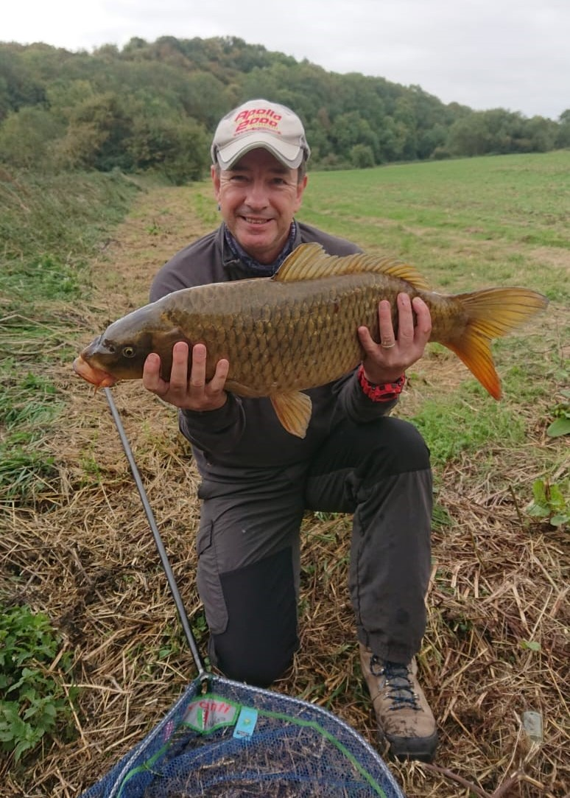
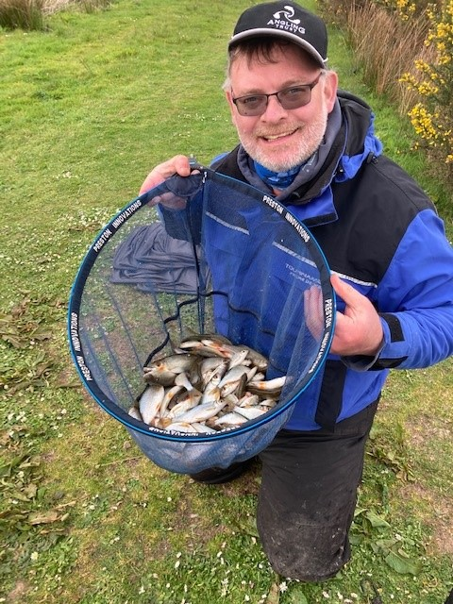

Today’s Speakers…
Richard Hadley
Lead Safeguarding Officer and
Coaching Centre Manager
Stuart Sharp
Head of Delivery

Slide 3
Outline of this forum
Inform you of why we are asking clubs to appoint a Welfare Officer
Provide background information and best practice around safeguarding
Explain how this links with your inclusive insurance
Answer any questions you may have
Launch training offer

Slide 4
Reasons to consider welfare and safeguarding
Good practice – it protects you as club officials and your members
Insurers are looking for improved governance = reduced risks
Expectations on all clubs across sports/pastimes in light of the Whyte review

Slide 5
What is safeguarding?
The Action that is taken to promote the welfare of children and young people and protect them from harm “ NSPCC”
Protecting an adults right to live in safety, free from abuse and neglect.
It’s about people and organisations working together to prevent and stop abuse or neglect. Whilst having regard to their views wishes feelings and beliefs

Slide 6
What is the role of the Club/Fishery Welfare Officer?
Visible point of contact for members
Liaison with Angling Trust on any safeguarding concerns
To share information with the club committee and members
To capture details of any concerns reported within the club and to report them to AT and/or Police as appropriate
To lead on the club’s safeguarding policies and procedures
Listen to members

Slide 7

Legislation
Children Act 1989 and 2004 (NI Order 1995)
Social and wellbeing act 2014
Wales safeguarding procedures
Working Together 2018 guidance
United Nations Convention on the Rights of the Child 1991
CPSU Safeguarding in Sport Standards.
reviews - Sheldon, Quinlan, LTA/Tennis. Wales -Wrexham Tennis and Whyte review

Slide 8
Summary of Whyte Review for Sport
Sports traditionally prioritise income and participation over welfare of members
Historical practices are accepted without question and lack of reporting protocols and procedures
To promote the Welfare of Anglers, all areas of business need to consider Diversity and Inclusion, Safeguarding and HR

Slide 9
What you need to do
Appoint a Welfare Officer
Adopt Safeguarding Policies
Introduce Procedures for the Safe Deployment of Staff and Volunteers
Share this Information with Members
Record your decisions
Provide us with your Welfare Officers contact details

Slide 10

Four Conditions Model
Reporting Protocols and providing opportunities
Policies, Procedures
Motivation
Internal Inhibitors
External Inhibitors
Overcoming resistance

Slide 11
Tools
At https://anglingtrust.net/club-resources/#clubsafeguarding you will find guidance and templates for:
Safeguarding policies – children and adults
Incident reporting form
Responding & Reporting process
Volunteer checking guidance
Disclosure and Barring scheme check

Slide 12
What happens if we do not follow the guidance?
We strongly recommend that all clubs & fisheries appoint a Welfare Officer and adopt safeguarding policies, but this is not mandatory and the choice remains yours.
If your club/fishery decides not to appoint a Welfare Officer and/or adopt safeguarding policies, you should record your decision and reasoning.
In the event of an incident that gives rise to an abuse claim, insurers may request sight of your policies or your reasoning for not adopting any.
Insurers consider each case of its own merit and they may decline claims where best practice has not been followed.

Slide 13
Any Questions?
Any questions may be sent to us at welfareandsafety@anglingtrust.net
Reports of safeguarding incidents should be sent to as at safeguarding@anglingtrust.net

