Slide 1
Bass Fisheries Management Plan Evidence Gaps
Notes:
I'm Katie St John Glew and I work for Defra as an Evidence lead for bass and the FMP programme as a whole.
My job is to collate and then communicate evidence and advice to support policy decisions. So to emphasise - I am not a policy maker - I am a scientist who works with policy makers.
I am just going to provide a brief update on FMPs – specifically bass, the evidence used to support the bass FMP and the evidence gaps, and work that has been done earlier this year on how we collaboratively fill evidence gaps.
I do need to caveat everything with the fact that we are immediately post-election and all of this and what happens next is subject to the views of the new government

Slide 2
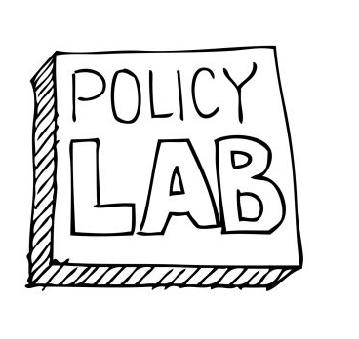
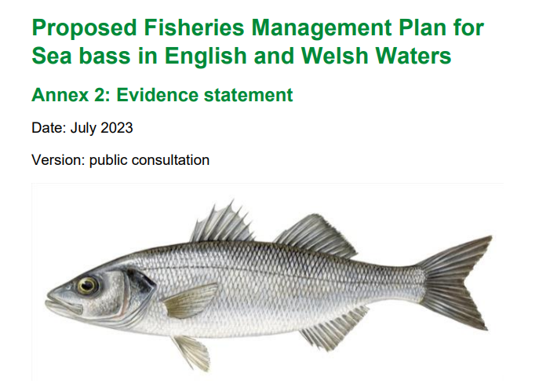
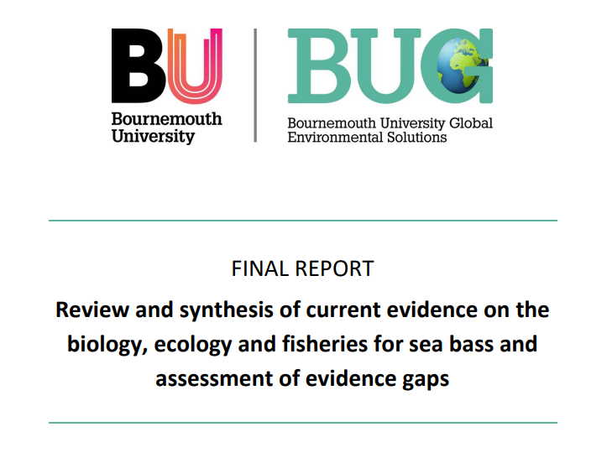
Bass FMP & Evidence
Notes:
The Bass FMP was developed using a range of evidence sources
The first being led by Policy Lab who facilitated a co-design process with regulators, scientists and fisheries to work together and find solutions for the bass FMP, which balance social, economic and ecological requirements. This project ran from March to December 2022. The final report was published during the bass FMP consultation.
Evidence was also gathered from internal government sources and collated into an Evidence Statement which was also published during the consultation. The aim of this document was to set out the current baseline knowledge on what we know about bass, and those fishing bass, and where our gaps in knowledge are. This document collated evidence from Cefas on the biology of bass and ICES stock assessments, landings data from MMO and economic data from Seafish.
And to gather a broader perspective on the current evidence base, a literature review was commissioned to Bournemouth University who put together a report summarising the published evidence on bass biology, stock structure, habitat preference, migration behaviours, and ecological interactions, as well as information on bass landings, discards and survival of discards as well as the social and economic and regional importance of fishing bass.
Using all of these sources, and the consultation responses, a list was also developed of evidence gaps - the things we still need to know to support the sustainable management of bass.

Slide 3
Bass Evidence Gaps
Bass Life History
Spawning timing in different regions
Environmental factors that influence recruitment success
Extent to which adults return to specific spawning areas
Larval dispersal patterns
Relative importance of different nursery areas
Bass Fisheries
Recreational fisheries catches
Abundance and distribution – sea bass specific survey
Under 10m landings
Notes:
There are some evidence gaps which are very specific to bass, some which are specific to bass and other FMP finfish, and some which are important for all FMP species
Those which are more specific to bass are listed over the next couple of slides - ordered into different topic themes
First is Bass life history - so some questions on better understanding bass as a species to support in management decisions, these include:
Understanding spawning timing in different regions, and the extent to which adults return to specific spawning areas
Understanding larval dispersal patterns and the relative importance of different nursery areas
Understanding environmental factors that influence recruitment success
Then we have questions on better understanding bass landings and those landing bass
Understanding recreational landings
We don't have a Bass specific survey and we need to better understand abundance and distribution

Slide 4
Bass Evidence Gaps
Management
Quantify benefits & limitations of size-based management
Impacts of management approaches on recruitment success & biomass
Stock structure
Discards
Quantifying discards
Discard survival
Bycatch
Quantify bycatch risk to salmon
Quantify bycatch risk to protected species
Understand effective bycatch mitigation methods
Notes:
There are evidence gaps on helping understand the best course of management actions
Better understanding the impacts of different management approaches
Better understanding stock structure to support management and
Specifically for bass to quantify the benefits and limitations of size-based management
And then also some evidence gaps on better understanding the number and survivability of discards, as well as bycatch risk of these fisheries and how this risk is mitigated.

Slide 5
Wider Evidence Gaps
Benthic
Impacts
Climate Change - adapt
Climate Change - mitigate
Social and Economic
Wider Environment
Notes:
We then have a whole list of evidence gaps that apply to all fish stocks and sustainable management in general
These include:
The impact of fishing on benthic habitats and the wider environment and ecosystem
The impact of climate change and how fisheries can adapt to these impacts
Better understanding how fisheries can support in mitigating against climate change such as reducing vessel emissions and minimising risk to blue carbon habitats
And quantifying the social and economic benefits of FMP commercial and recreational fisheries to local communities
These are not all of the evidence gaps but a selection of areas that need improved evidence to support management decisions.

